Slide 1
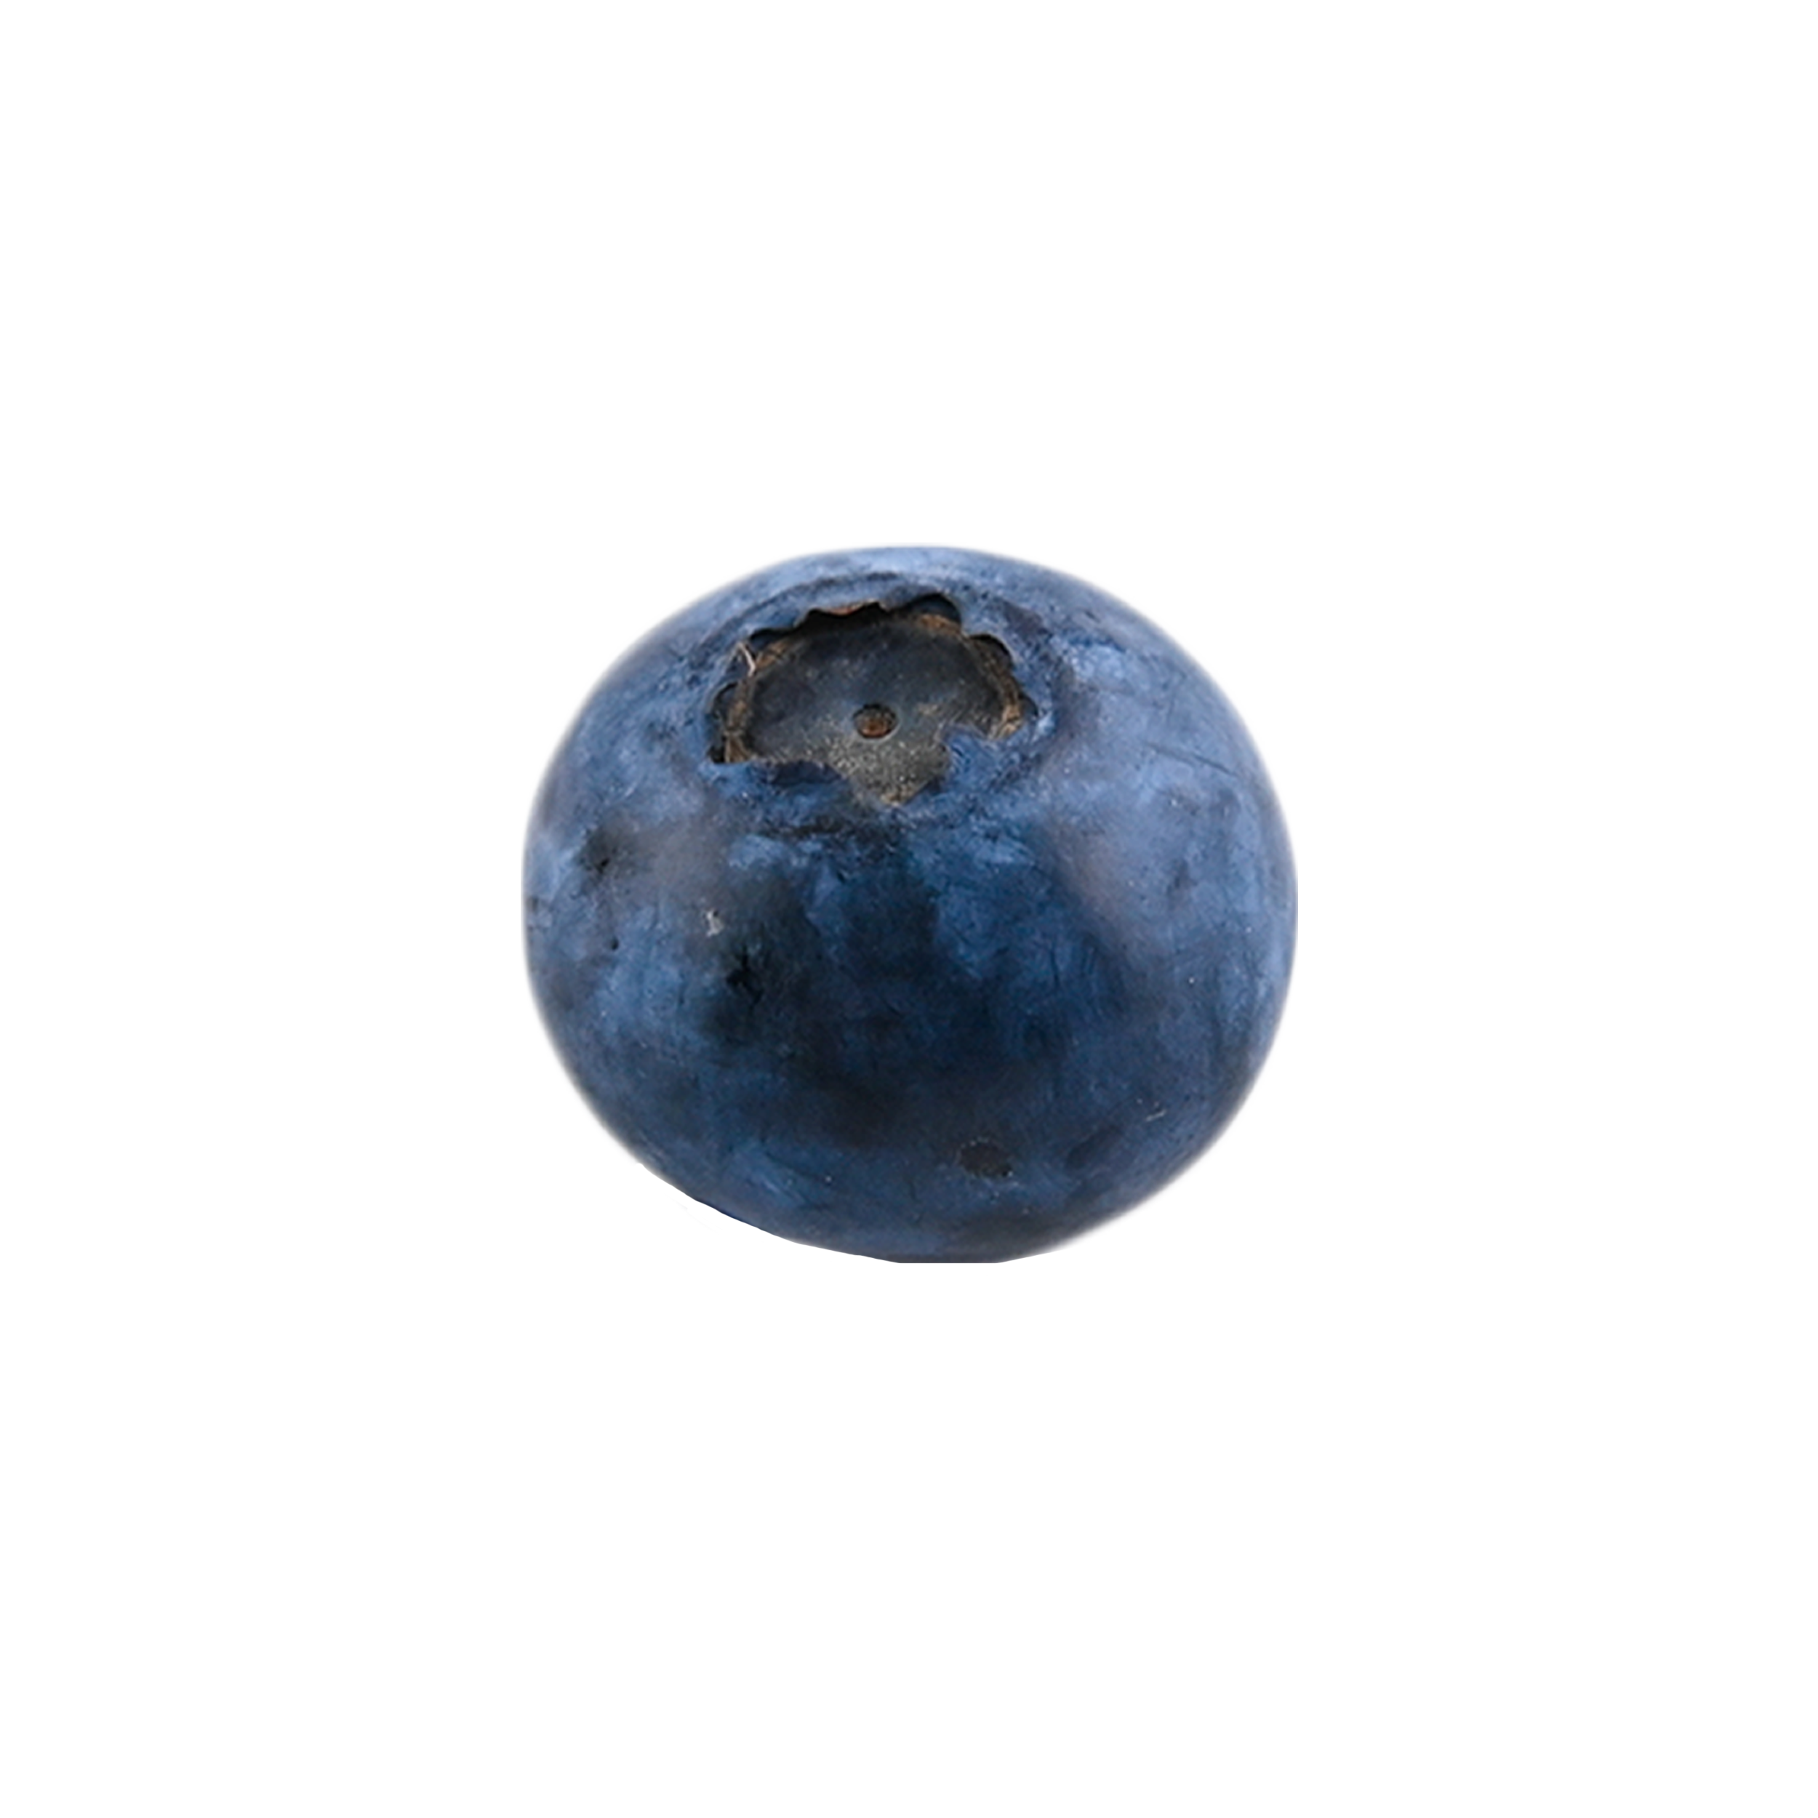
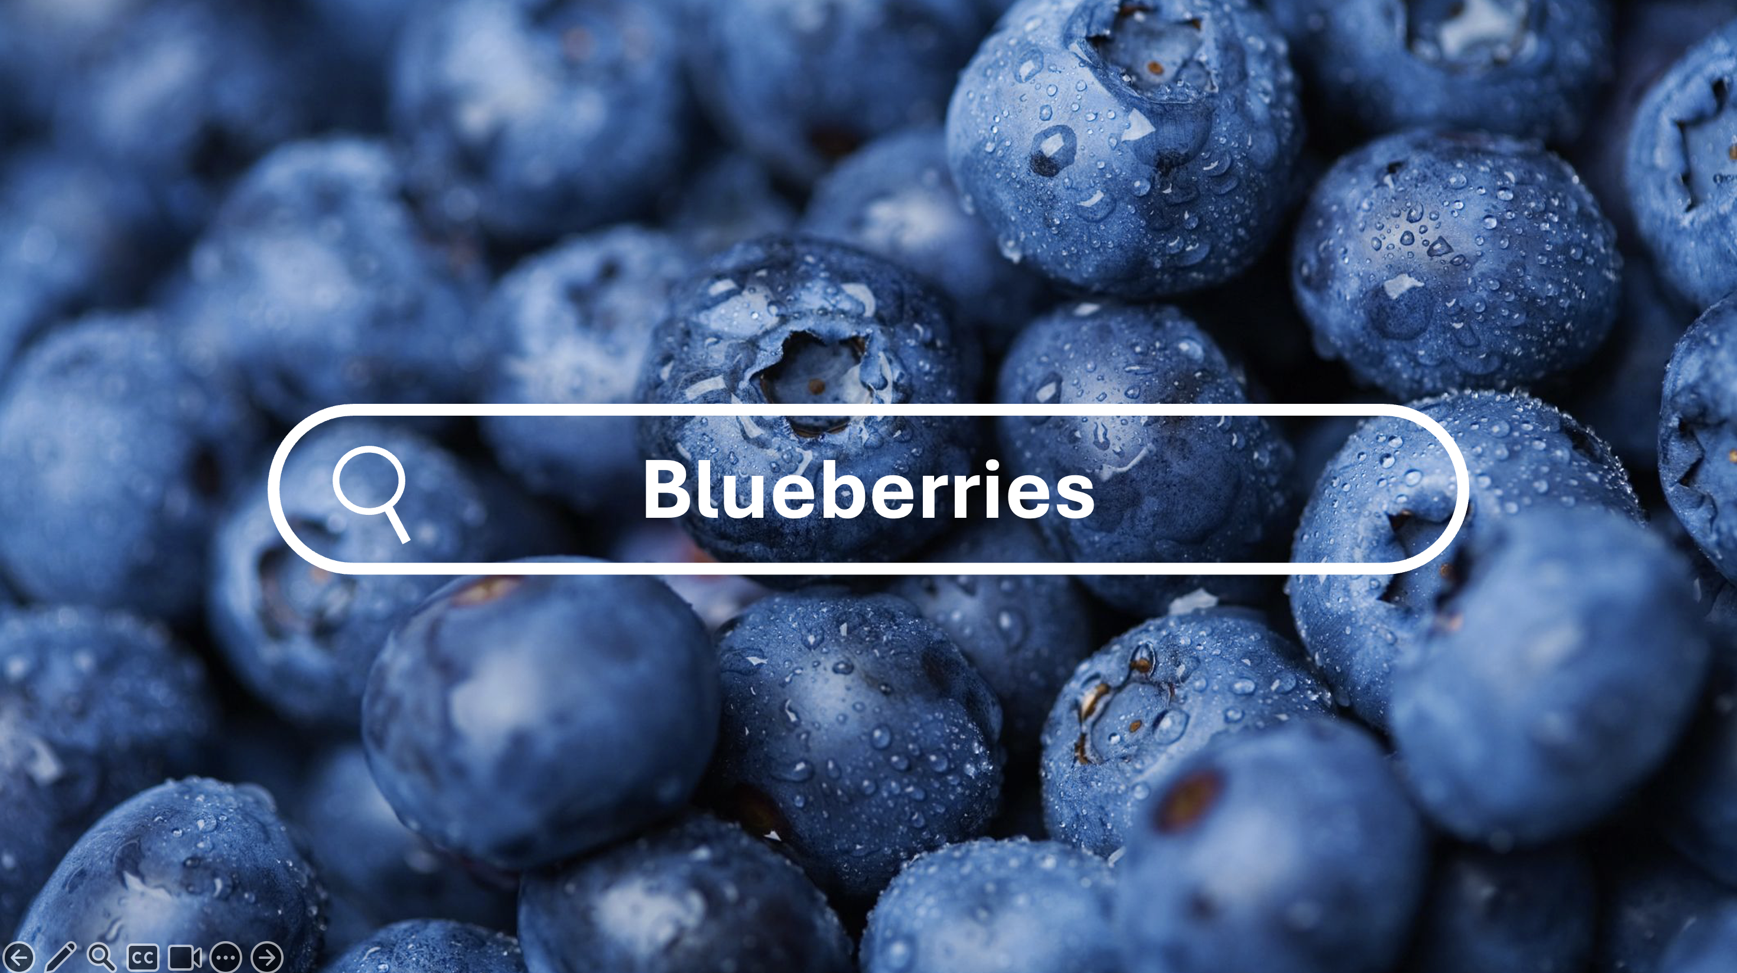

Blueberries
Consistently find expired food in your fridge?
International student suffer from Australian prices?
Search your best fridge organizer:
Blueberries!

Slide 2

Blueberries
Consistently find expired food in your fridge?
International student suffer from Australian prices?
Search your best fridge organizer:
Blueberries!

Slide 3
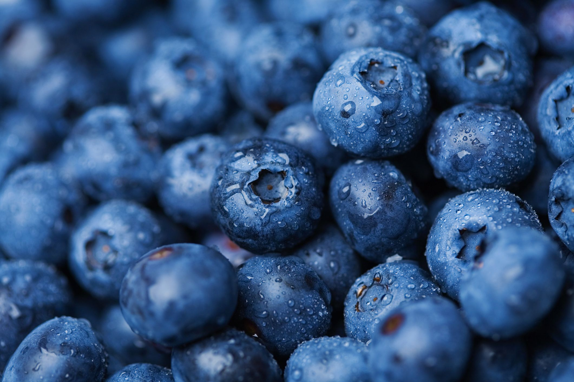

blueberries?

Slide 4




blueberries?
Keep track of what’s in your fridge
Add wanted item to your shopping list
Item name
Quantity
Share a fridge and a shopping list with
Your roommates
Your family
Easier to know the expiration dates of food
Enter expiration dates of each item
Stop you from wasting food and money
Enter your budget
Blueberries will help you calculate how much you have spent

Slide 5
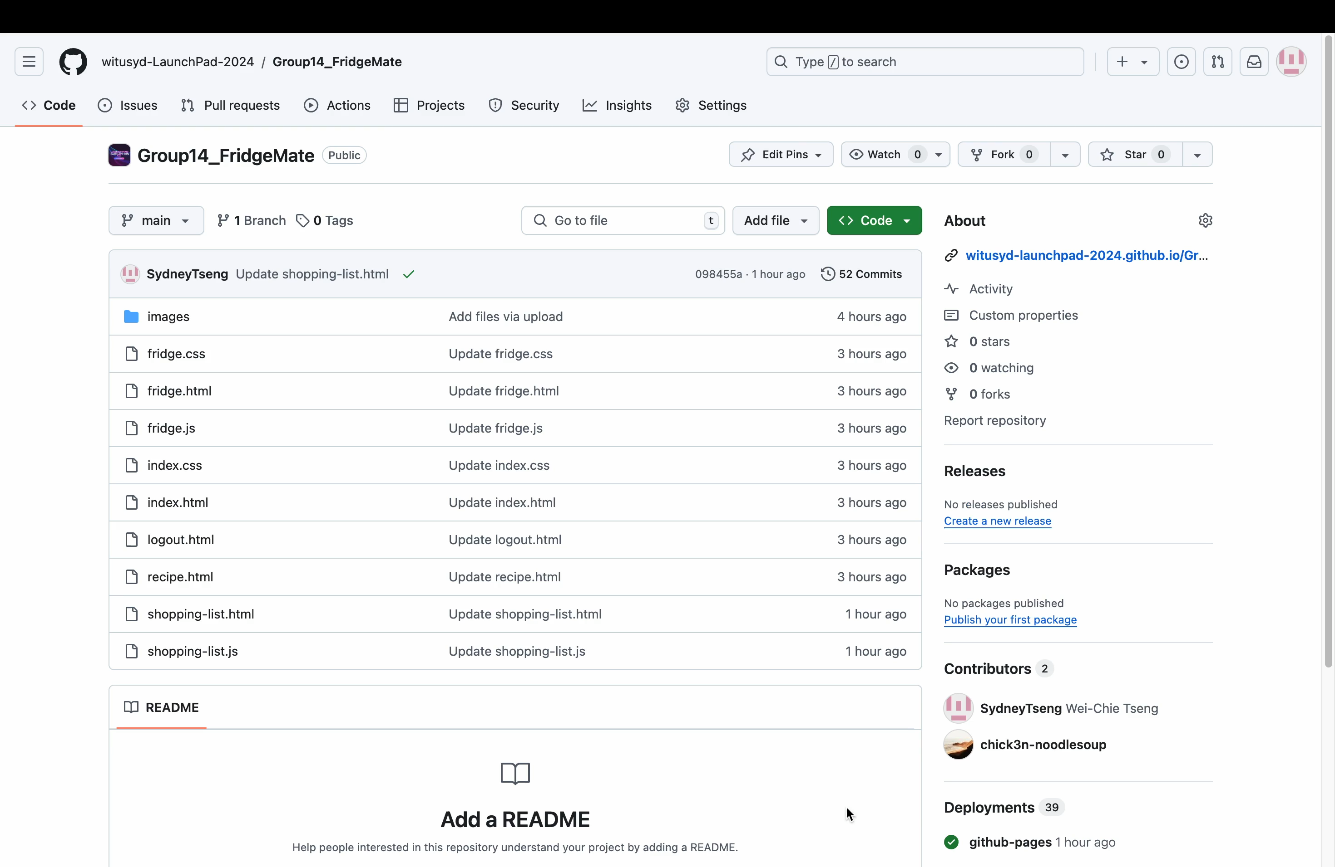

Slide 6
blueberries?
Keep track of what’s in your fridge
Add wanted item to your shopping list
Item name
Quantity
Share a fridge and a shopping list with
Your roommates
Your family
Easier to know the expiration dates of food
Enter expiration dates of each item
Stop you from wasting food and money
Enter your budget
Blueberries will help you calculate how much you have spent

Slide 7
Future Goal
Expiration reminder
Recipe recommendation
Connect with supermarket

Slide 8
Thank You!

